Slide 1
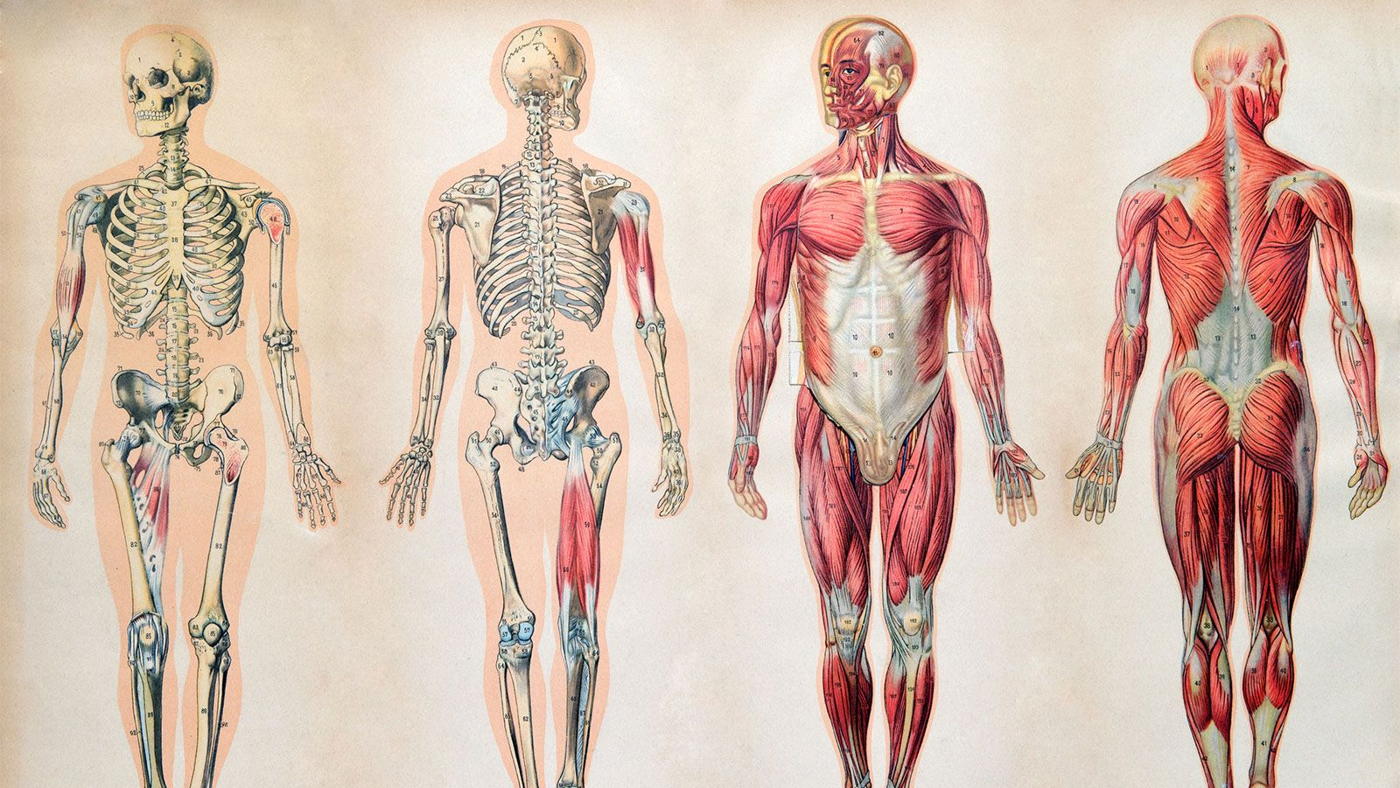
The Deviant Body
Notes:
Four images of the human body showing the skeletal and muscular systems

Slide 2
Setting up our discussion
Why study bodies?
Keeping it sociological
“Deviant” as non-perjorative

Slide 3
Institutional Regulation of Bodies
Rules, norms, and laws that control how people look, move, act, and/or use their bodies

Slide 4
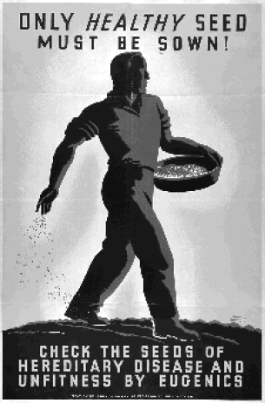
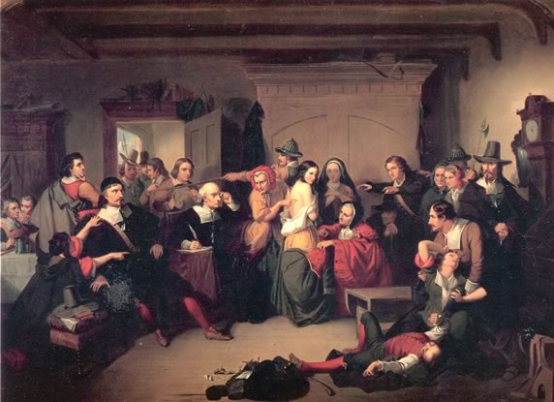
Notes:
Painting “Examination of a Witch” by Matteson and a poster from a US Eugenics Society

Slide 5
From Chicago’s Municipal Code Ordinance 1911 (sec. 36034)
“ No person who is diseased, maimed, mutilated or in any way deformed so as to be an unsightly or disgusting object or improper person be allowed in or on the public ways or other public places in this city, or shall therein or thereon expose himself to public view, under a penalty of not less than one dollar nor more than fifty dollars for each offense”

Slide 6
Elements of Deviance
A norm must exist (about attitudes, behaviors, or characteristics)
The norm must be broken (or believed to be broken)
A social audience must react negatively (apply social control)

Slide 7

Dimensions of Physical Deviance
Bodies that don’t meet the collective’s Aesthetic Ideals
Bodies that don’t meet the collective’s conceptions of Physical Capacity
Bodies that challenge strongly held social constructs about personhood

Slide 8
Aesthetic Ideals
Beauty Culture: the values, norms, and material goods in support of a culture-specific aesthetic ideal
Lookism: discriminatory treatment towards people who are evaluated as not meeting a society’s beauty standard
“Beauty premium”: economic advantages for people who meet a society’s beauty standard
“Halo Effect”: the attribution of positive personal qualities to people who meet a society’s beauty standard

Slide 9
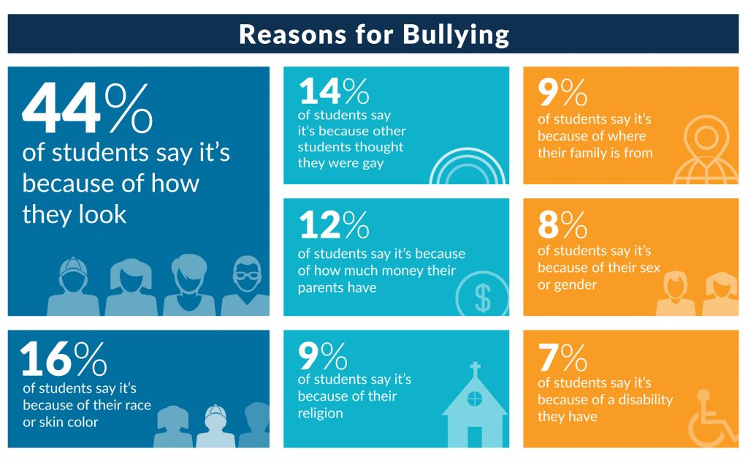
Notes:
Yale study of High School bullying 2015

Slide 10
Status: any named social position a person can occupy
Ascribed statuses: Social positions that are believed to be acquired at birth, involuntarily, or imposed outside of the individual’s will.
Achieved statuses: Social positions that are believed to be acquired through an individual’s own efforts, actions, or choices.

Slide 11
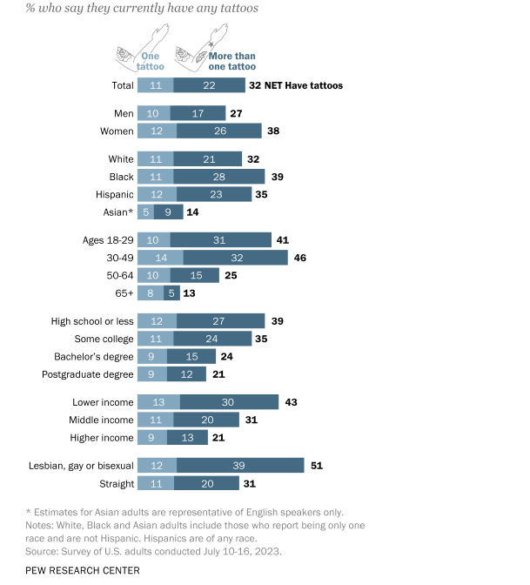
Body modifications: deviance in decline?

Slide 12
Stigma: a deeply discrediting quality that is viewed as an obstacle to competence, trust, or group membership
(Goffman)
Blemishes of Individual Character: personal qualities and behaviors that risk disqualification
Stigma of Tribe: group affiliations that risk disqualification
Abominations of the Body: physical characteristics that risk disqualification

Slide 13
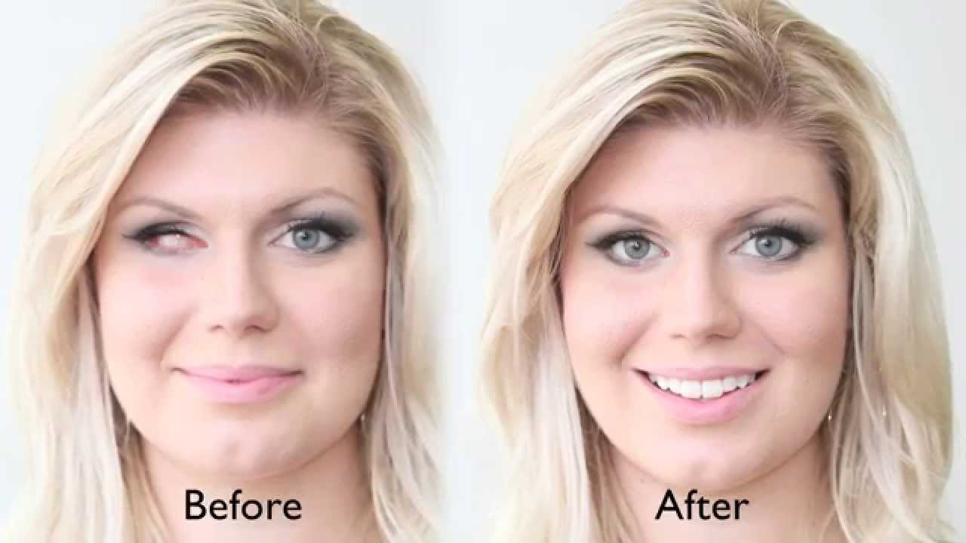
Stigma Sign: a socially significant visual mark of difference
Discredited: open or obvious cues
Discreditable: hidden/able to be hidden cues
Notes:
Image taken from an advertisement for prosthetic eyes

Slide 14
Experiencing Stigma
Being seen as an “open body”
Invisibility
Courtesy Stigma: stigma that is extended to associates
Avoidance

Slide 15
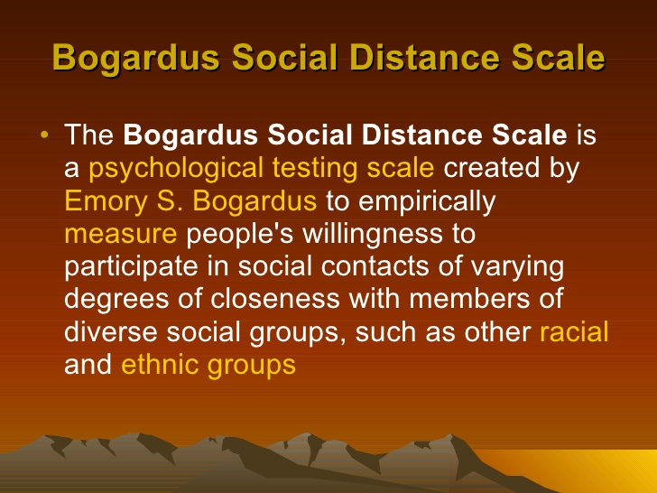
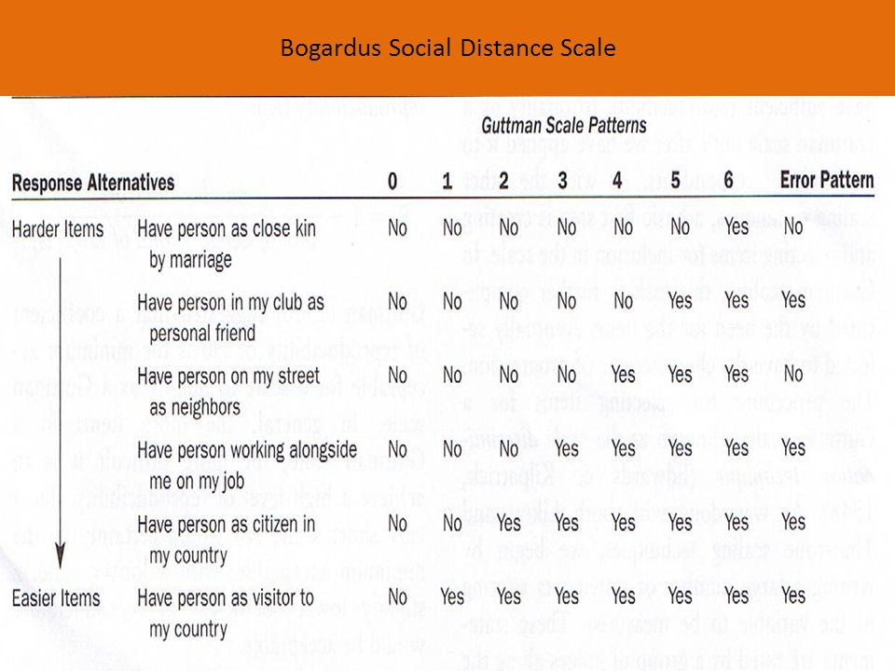

Slide 16
Explaining Avoidance: Dissonance Theories
Just World Hypothesis (Melvin Lerner): people are motivated by a belief that the social world is an orderly and just place and that good people are rewarded, and “bad” people are punished because actions have predictable consequences.
Vulnerability Reminders: discomfort at visible reminders of the inherent vulnerability of the human condition

Slide 17
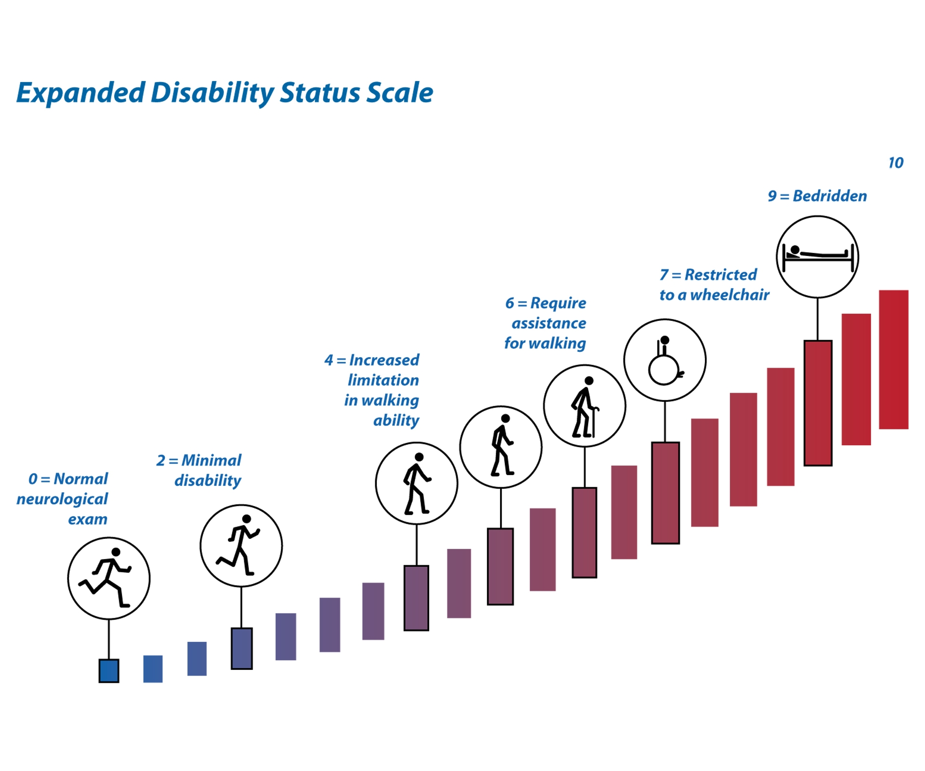
Medical Models of Disability

Slide 18
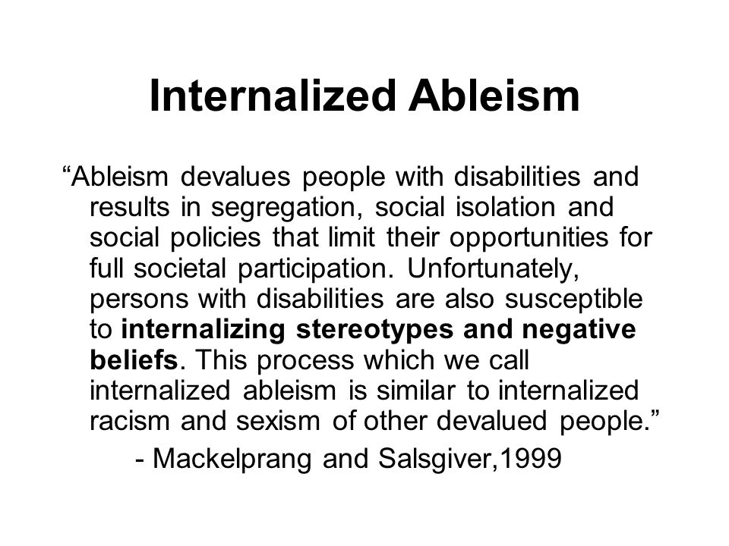
Internalization
Cultural
Paradigms
Structural Oppression
Meaning Making
Perpetuating oppression of oneself
Internalized Oppression
Perpetuating Oppression of Others

Slide 19
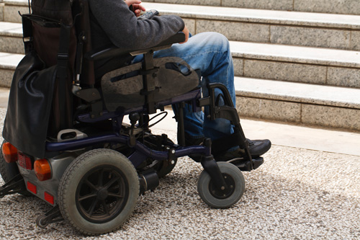
Social Model of Disability
Notes:
Image of a wheelchair user in front of a set of stairs

Slide 20
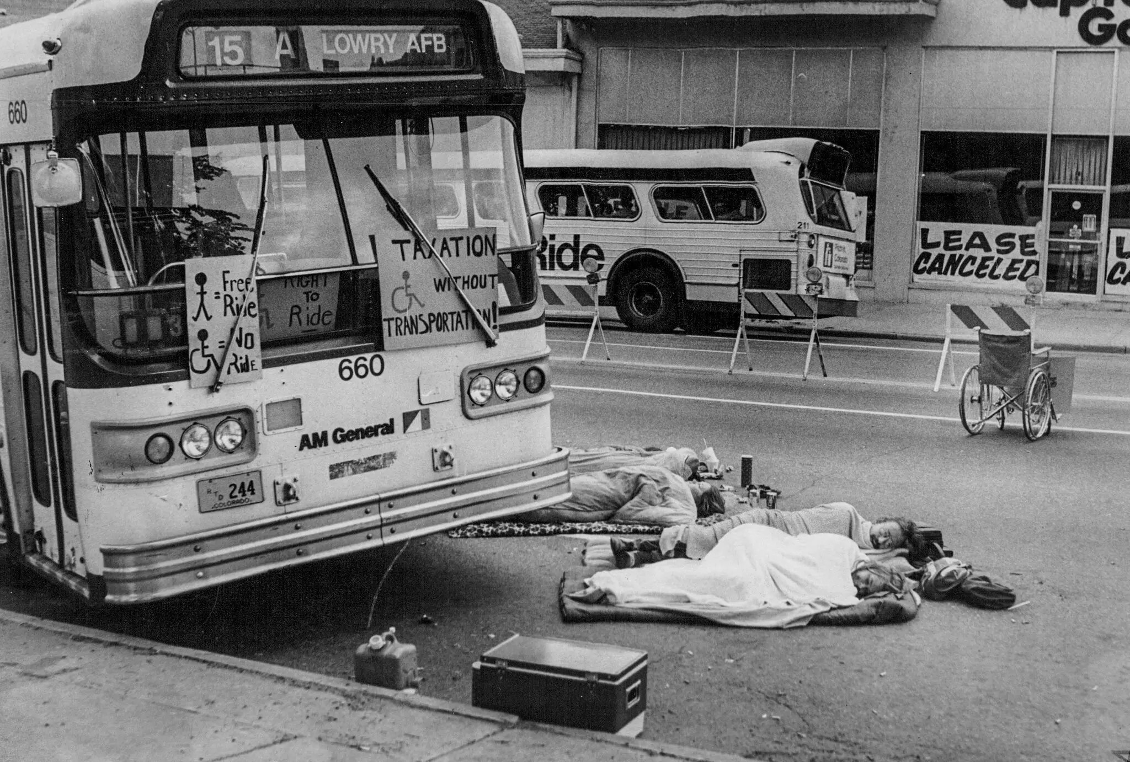
Resistance and Tertiary Deviance
Notes:
1978 Transportation Protest

Slide 21
Americans with Disabilities Act (1990)
Title I: Addresses employment barriers
Title II: Addresses state and local government barriers (transit)
Title III: Addresses public and commercial (architectural)
Title IV: Addresses barriers in telecommunications
Title V: Addresses additional miscellaneous provisions

